Slide 1

We Build To Make You Proud
Online Session
Google Tag Manager
Date: 18-May-2023

Slide 2
Index
Introduction
What is GTM?
Why should we use GTM?
Components of GTM
GTM account structure
GTM setup
Tags & Triggers
How to share user management access in GTM

Slide 3
Introduction
Google Tag Manager is a tag management system (TMS) that allows you to quickly and easily update measurement codes and related code fragments collectively known as tags on your website or mobile app.
It is a function developed by Google in October 2012, with the help of which you can integrate web tracking into your own website without the support of an IT specialist.

Slide 4
What is GTM?
Google Tag Manager is a free software tool that allows you to install different types of tags on your website.
Examples:
Google Analytics, Google Adwords, Facebook Pixels etc.

Slide 5
Why should we use GTM?
Benefits
It's completely free
Made for non - programmers with ease to use.
Fast implementation
All tags at one place
No need for developers to implementation of heavy javascript tags on the website.
Troubleshooting is easy
Decrease page loading time by firing the required tags in GTM
Users and Permissions Management

Slide 6
Major components of GTM
Tags: Tags are the piece of Java codes added to the website in order to collect information.
Triggers: Triggers are the special condition that decides whether a tag should be fired or not. It is an important integral part of Tags
Variables: A variable is used to store data that is used in defining a trigger.

Slide 7
GTM Account Structure
Google Account
GTM Account
GTM Container Tag
Tags
Triggers
Variables

Slide 8
GTM Setup
Step 1: Create a Google login id.
Step 2: Create a new GTM account using the Google Login
Step 3: Log in to your GTM account
Or
If the account is already created - open tagmanger.google.com and choose the correct mail id
Step 4: Click on the ‘Create account button
Step 5: Name your new GTM account
Step 6: Select your country
Step 7: Name your new container
Step 8: Select ‘web’ as the target platform.
Step 9: Click on Create button

Slide 9
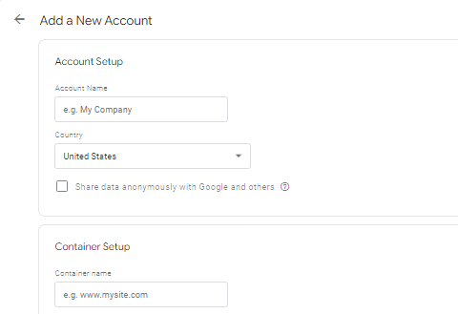
GTM Setup

Slide 10
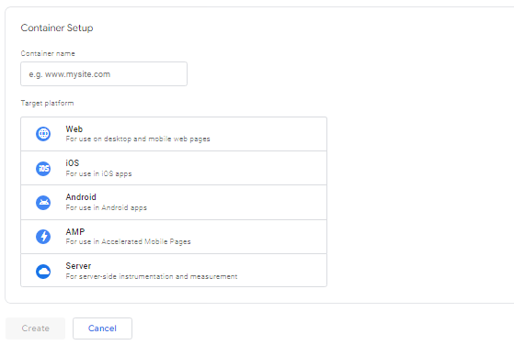
GTM Setup

Slide 11
GTM Setup
Step 10: Read and accept the GTM terms of service agreement.
Step 11: You will receive two codes
Add the 1st code in the uppermost part of the head section of the website and
Add the second code in the body of the website.
NOTE: Even if we add the head code in the body section it will work but it's recommended to add it in the uppermost part of the head section.

Slide 12
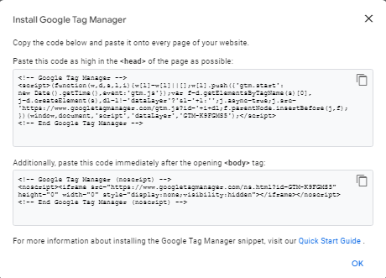
GTM Setup Code

Slide 13
GTM Setup - Inspection
Check GTM is installed on the website
Plugin - Google Tag Assistant Legacy
Search for code .js or .gtm in the source code
After Tags & Trigger creation
Use preview and debug mode - after Tags creation

Slide 14
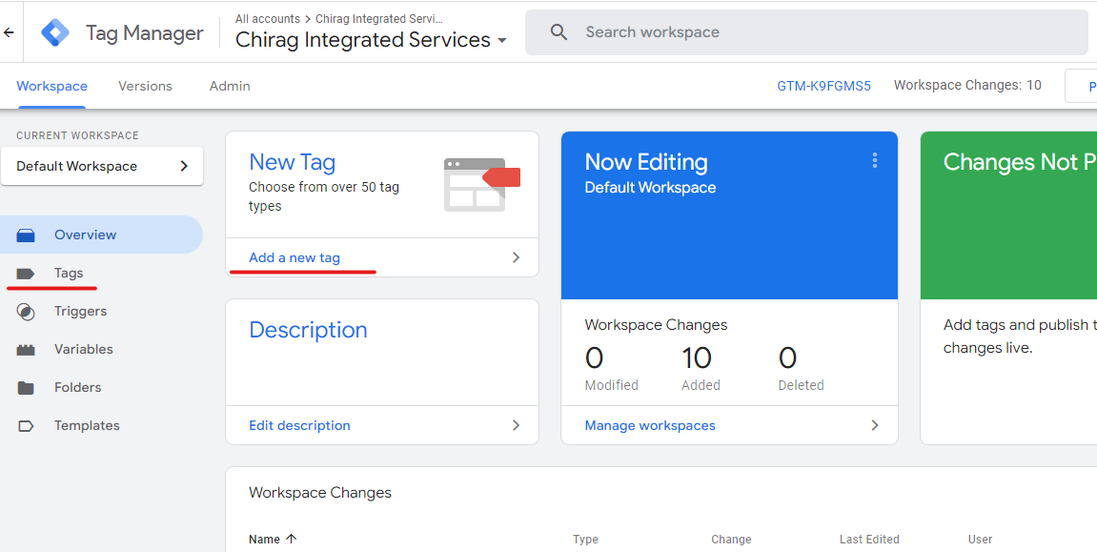
GTM Interface

Slide 15
Tag & Triggers
Create the Tags for each activity you want to track on the website.
Assign a proper name to the tags
Create the trigger for the each tags and add the proper variables so that each trigger fires only when the required condition are met.

Slide 16
Tags
Types of Events Tracking
Page View(Compulsory for GA4)
Calls
Form fills(Compulsory for GA4)
Emails

Slide 17
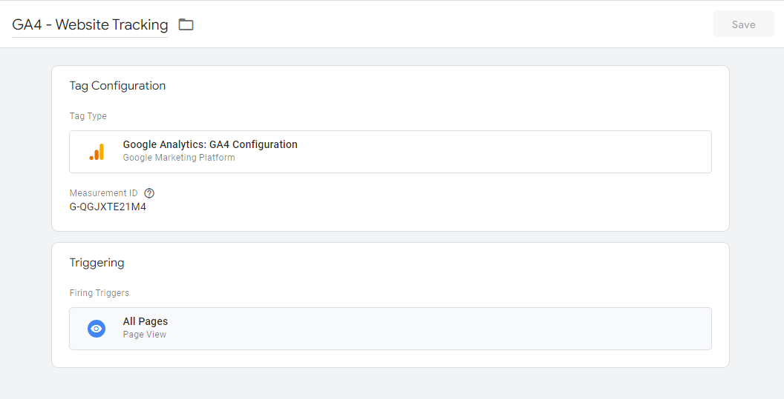
GA4 - Page views Tracking

Slide 18
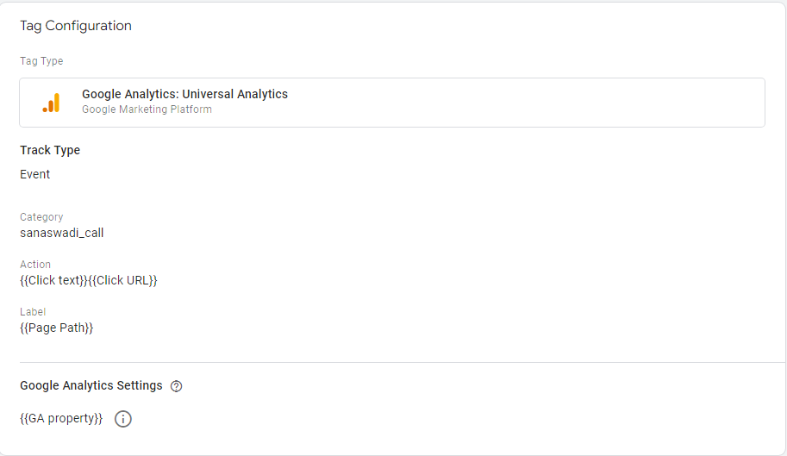
Call Tag

Slide 19
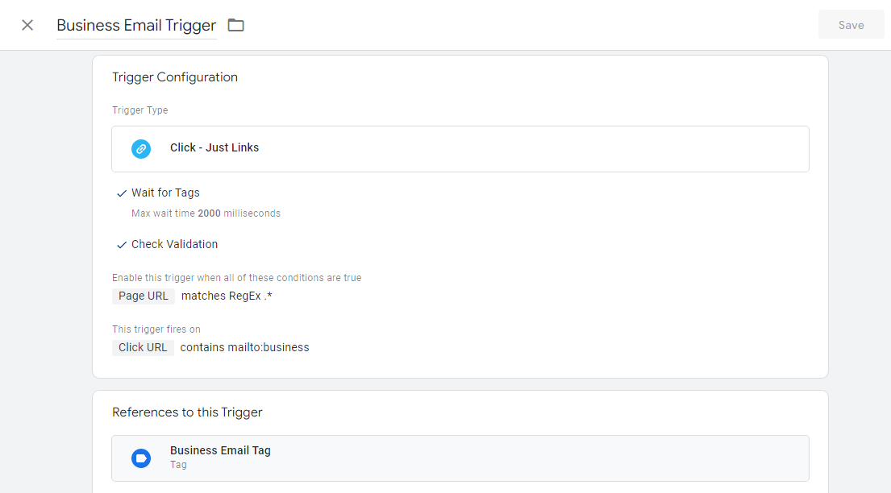
Email Trigger

Slide 20
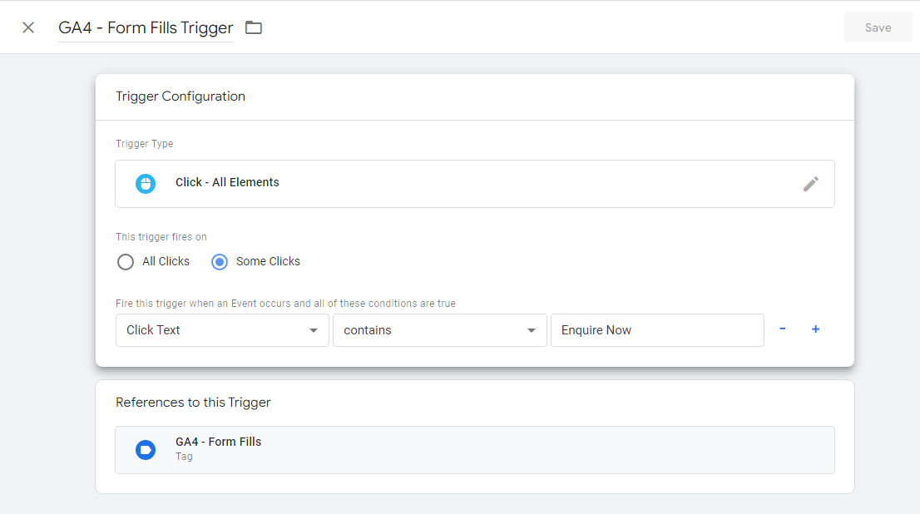
GA4 - Form Fills Trigger

Slide 21
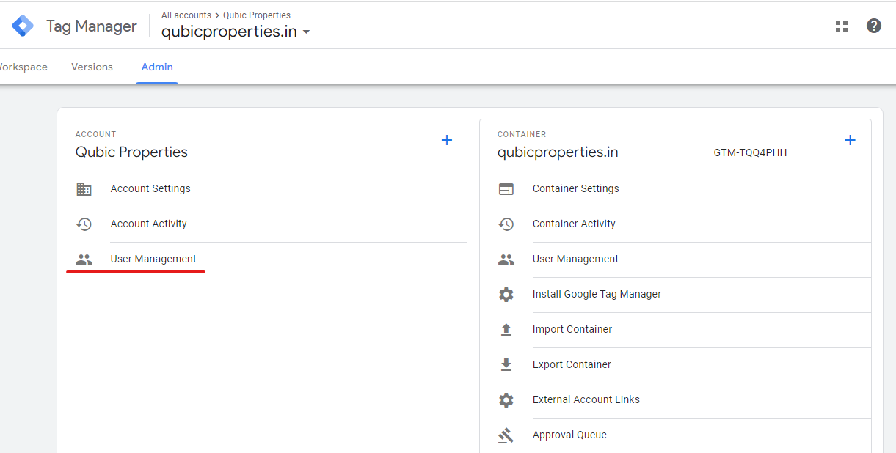
User management access in GTM Setup

Slide 22

THANK YOU

